Slide 1
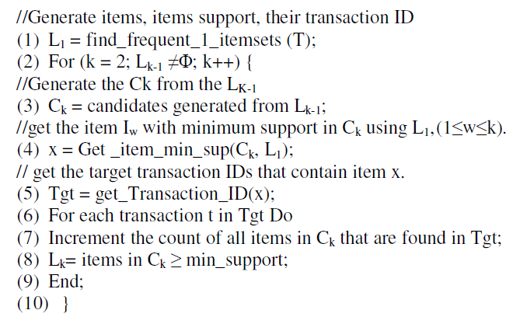
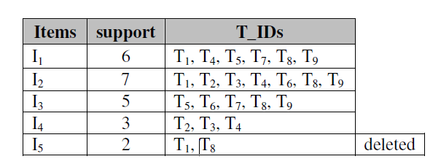
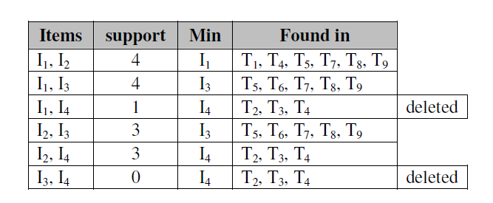
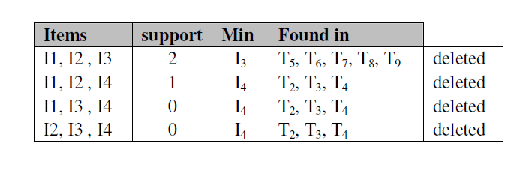
Literature Review: Improved Apriori Algorithm
For Data Mining Field
Reduce time consuming than Apriori algorithm
The smaller the number of combination,
the better -> 이게 우리한테 적용?
Set up
Set minimum support value
Evaluate frequent k based on first frequent 1
Repeat this until there isn’t new frequent item sets
I5같은 아이템은 어떻게 처리할건지?
Al-Maolegi, M., & Arkok, B. (2014). An improved Apriori algorithm for association rules. arXiv preprint arXiv:1403.3948.
Notes:
Apriori algorithm = To calculate C3 using L2
Improved Apriori algorithm = To calculate C3 using L1
Eliminate the candidates that are infrequent or their support are less than the min_sup.

Slide 2
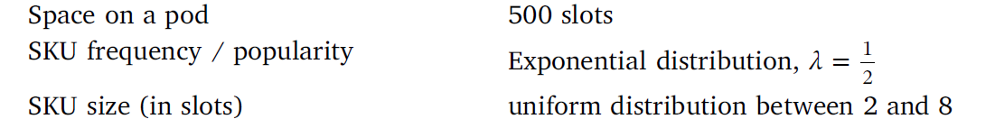
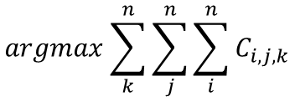
Methods
Process this datasets using this algorithm
Find every itemset(group) of three of 134 items
Based on frequency of each items, Delete combinations which have minimum frequency
Find maximum sum of group support value
Use this combination
Insert this combination and item distribution on RAWSim-O
Input: Bundle size, Groups(Frequency value), Probability, Frequency of one item, weight
Add RPS(Replenishment Pod Selection) decision rule of Controllers
It is about allocating one group in one pod
The number of groups is same to that of pods
FP-Growth Algorithm
Consider every item
Compute the support value easily
$$argmax\sum_{k}^{n}{\sum_{j}^{n}{\sum_{i}^{n}{C_{i, j, k}}}}$$
세걸 그림 첨부
Notes:
앞에 데이터 처리 방식이랑 합치거나 해야할듯

Slide 3
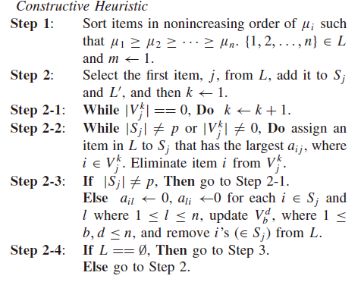
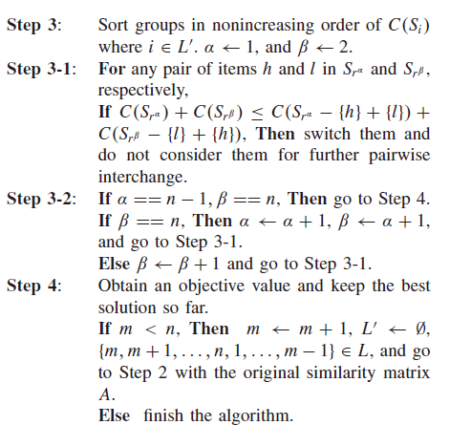
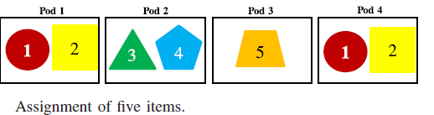
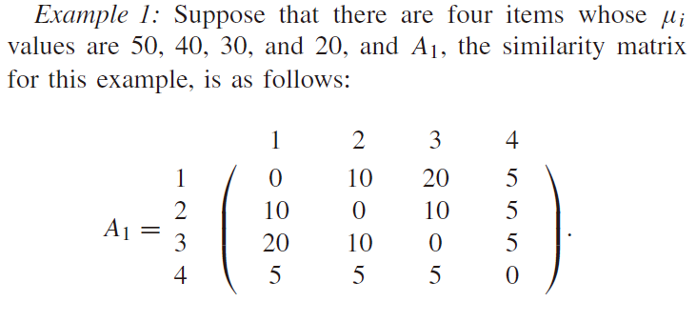
Backup
Notes:
I5같은 아이템은 어떻게 처리할건지?

